Slide 1

Exploiting Hardware Transactional Memory for Efficient In-Memory Transaction Processing
Computer System Design & Implementation, Spring 2019(IPADS, SJTU)
Hao Qian, Zhaoguo Wang, Haibing Guan, Binyu Zang, Haibo Chen
Shanghai Key Laboratory of Scalable Computing and Systems, SJTU
杨雁飞 2019-03-29

Slide 2
Outline
Background & Target
Design
Evaluation

Slide 3
Transaction Conflict & Concurrency Control
Concurrent transactions may conflict
Error State
Concurrency Control to get correct result
2PL, OCC
init A=B=C=D=0
Tx1 -> Tx2 : A=0,B=C=D=2
Tx2 -> Tx1 : A=0,B=C=1,D=2
Tx1
Tx2
r₁(A)
w₂(B,2)
w₁(B,1)
Conflict!
w₂(C,2)
r₁(A) w₁(B,1) w₂(B,2) w₂(C,2) w₂(D,2) w₁(C,1)
A=0,B=2,C=1,D=2
Error!
w₁(C,1)
w₂(D,2)

Slide 4
Hardware Support Conflict Detection
Traditional concurrency control need extra efforts to detect or avoid conflict
Lock-based Structure
Conflict occurs when two cores(threads) executing transactions read/write same memory address
A core’s cache using cache coherence protocol to maintain a consistent view for same memory address when read/write
Cache can detect other core’s read/write behavior!

Slide 5
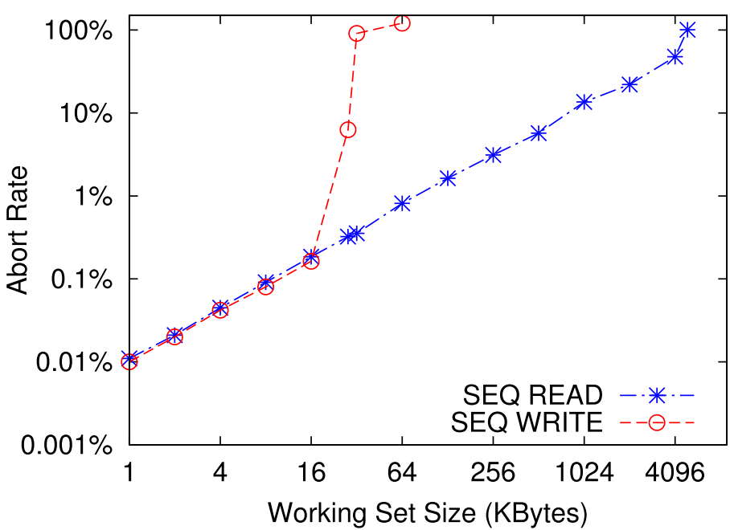
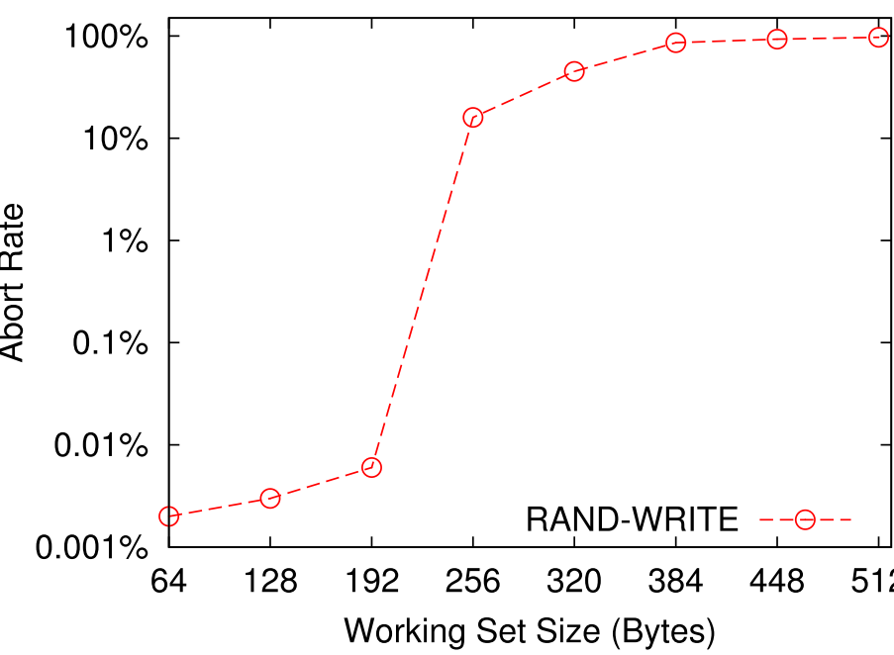
Hardware Transaction Memory(Intel RTM)
Three instructions
_xbegin, _xend, _xabort
Modification exposed only after successfully commit.
Discard all modification when abort
System Interrupts or other context switch
Read/Write set conflict
Capacity abort
Read at most 4MB and write at most 31KB in Intel Haswell
Also occurs when a single cache set is full
Larger working set → higher abort rate
Sequential Access
Random Access

Slide 6
Problem of Naïve Usage
Abort frequently: no transaction exceed the total capacity limitation but still with high abort rate
88% transactions fall back to coarse-grained locks
fallback handler
Transaction | Read(B) | Write(B) | Total(B)
NEWORDER | 7846 | 1938 | 8312
DELIVERY | 13567 | 4178 | 16404
PAYMENT | 2240 | 656 | 2372
STOCKLEVEL | 40101 | 1341 | 40493
ORDERSTATUS | 2241 | 469 | 2394
_xbegin()
abort
Transaction
_xend()
Transaction working set in TPC-C

Slide 7
Target
To get a lower abort rate
Reduce working set size
Reduce transaction conflict rate

Slide 8
Outline
Background & Target
Design
Evaluation

Slide 9
Key design points
Reduce working set size
Graph chopping
Database cache
Reduce transaction conflict rate
Deffered Execution
Read-only Snapshot

Slide 10
Graph Chopping
A chopping graph is an un-directed graph with a set of transaction operations connected with S-edges (sibling edges) and C-edges (conflicting edges)
A chopping is correct if there’s no sc-cycle
The order of conflict piece execution is the order of transaction execution
Tx1
Tx2
Tx1
Tx2
r₁(A)
w₂(B,2)
r₁(A)
w₂(B,2)
w₂(C,2)
C
S
S
S
C
w₁(B,1)
w₂(C,2)
w₁(B,1)
w₁(C,1)
S
S
C
S
w₂(D,2)
w₁(C,1)
w₂(D,2)
Put each piece into a RTM region to get a smaller working set per execution

Slide 11
Database Cache
Search and update table brings large working set
Add a little cache to store update instead of directing updating the table during transaction
Update the cache to database in a separate RTM transaction after the piece is finished

Slide 12
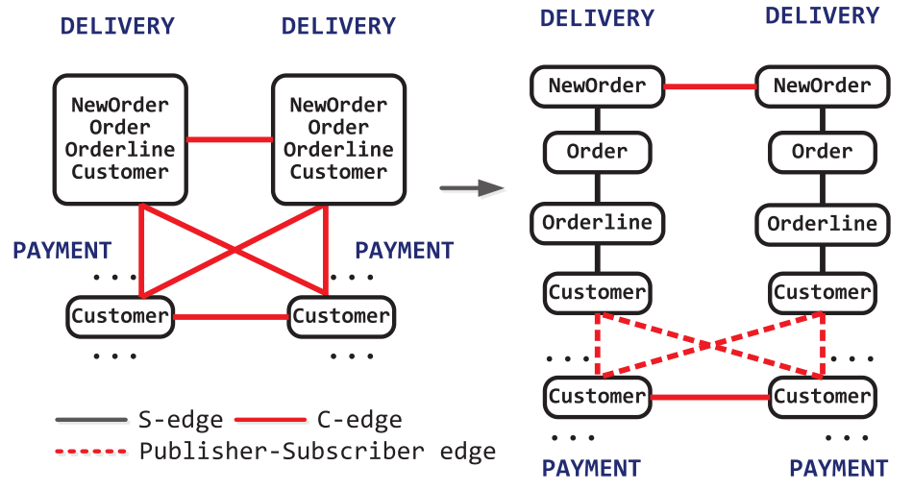
Deferred Commutative Operation Execution
An operation is commutative if the result is independent with the execution order while concurrently execute several operations
DELIVERY in TPC-C is commutative
Deferring commutative operation with operation that reads the result of it
Update locally and only publish the result after a period of time
Add a extra barrier during publishing to make sure no conflict
Defer edge

Slide 13
Read-Only Snapshot
Read-only Transaction accessing many records are likely to cause conflicts
Letting them read from a consistent but a little stale snapshot
Read-only transaction will never cause conflicts then
snapshot
SN₁
Tx_{r}1
Tx_{r}2
Tx_{r}3
SN₂
Tx_{r}4
Tx_{r}5
Tx_{r}6
database
S₁
S₂
S₃
S₄
S₅
S₆
S₇
S₈
Tx1
Tx2
Tx3
Tx4
Tx5
Tx6
Tx7
time

Slide 14
Snapshot Consistency
As a transaction is divided into pieces to commit with graph chopping, the snapshot state may not be consistent
Tx2: w₂(B,2) w₂(C,2) w₂(D,2)
Tx2 is partially finished in SN₁. Inconsistent!!
snapshot
SN₁
database
S₁
S₂
S₃
w₂(B,2),w₂(C,2)
w₂(D,2)
time

Slide 15
Consistency Requirement
Atomicity
The updates from the same transaction should be applied on the same snapshot.
Serializability
The order of different snapshots should agree with the serial order of committed transactions

Slide 16
Eventually Snapshot
Atomicity
Assign each transaction a snapshot number, and enforcing that all the updates from the same transaction are assigned with the same snapshot number
Tx2: w₂(B,2) w₂(C,2) w₂(D,2)
SN₁
SN₁’
S₁
S₂
S₂
w₂(B,2),w₂(C,2)
w₂(D,2)
time
GSN=SN₁
GSN=SN₂
Tx2=SN₁
Tx2 begin
Tx2=SN₁

Slide 17
Problem With Serializability
Assigning the snapshot number at the transaction begin do not hold serializability
Tx1: r₁(A) w₁(B,1) w₁(C,1)
Tx2: w₂(B,2) w₂(C,2) w₂(D,2)
SN₂
SN₂’
SN₁:B=C=1,D=0
SN₂:B=C=D=2
SN₁
SN₁
SN₁’
Tx2 is before Tx1 but Tx2’ s snapshot is after Tx1’s snapshot
S₁
S₁
S₂
S₂
S₂
r₁(A)
w₂(B,2) w₂(C,2)
w₁(B,1) w₁(C,1)
w₂(D,2)
time
GSN=SN₁
Tx1=SN₁
GSN=SN₂
Tx2 → Tx1
Tx1=SN₁
Tx2=SN₂
GSN=SN₃
Tx1 begin
Tx1=SN₁
Tx2 begin
Tx2=SN₂

Slide 18
Lazy Snapshot Assignment
For each transaction, when two instances are used to construct the chopping graph, each transaction has at most one conflicting piece in the chopping graph.
Tx1
Tx2
Tx1’
C
C
Tx1
Tx2
Tx1’
Piece i1
Piece k
Piece i2
S
S
Piece k
C
C
…..
…..
Piece i1
…
Piece j1
Piece i1
…
Piece j1
S
S
C
Piece j1
C
Piece j2

Slide 19
Lazy Snapshot Assignment
Assigning the snapshot number in the conflicting piece
Buffer the previous modification
Order of conflicting piece implies the transaction order
Tx1: r₁(A) w₁(B,1) w₁(C,1)
Tx2: w₂(B,2) w₂(C,2) w₂(D,2)
SN₂
SN₂’
SN₁:B=C=D=0
SN₂:B=C=1,D=2
S₁
S₁
S₂
S₂
S₂
r₁(A)
w₂(B,2) w₂(C,2)
w₁(B,1) w₁(C,1)
w₂(D,2)
time
GSN=SN₁
GSN=SN₂
Tx1=SN₂
Tx2=SN₂
GSN=SN₃
Tx2’s conflict piece Tx2=SN₂
Tx1’s conflict piece Tx1=SN₂

Slide 20
Commutative Operations
Commutative operation may cause inconsistency to snapshot
init A=B=0
Tx1: w₁(A,1) inc₁(B)
SN₁:A=1,B=1
SN₂:A=2,B=1
Tx2: w₂(A,2) inc₂(B)
SN₂
SN₂
SN₂’
B in SN₂ is excepted equal 2
SN₁
SN₁
SN₁’
SN₁’
S₁
S₂
S₃
S₃
S₃
w₁(A,1)
w₂(A,2)
inc₁(B)
inc₂(B)
time
GSN=SN₁
Tx1=SN1
GSN=SN₂
Tx1=SN₂
Tx2=SN₂
GSN=SN₃
Tx1’s conflict piece Tx1=SN₁
Tx2’s conflict piece Tx2=SN₂

Slide 21
Commutative Operations
Redo commutative operation in snapshots that are later than this operation’s snapshot
init A=B=0
Tx1: w₁(A,1) inc₁(B)
Tx2: w₂(A,2) inc₂(B)
SN₂
SN₂’
SN₂’’
SN₁:A=1,B=1
SN₂:A=2,B=2
SN₁
SN₁
SN₁’
SN₁’
S₁
S₂
S₃
S₄
S₅
w₁(A,1)
w₂(A,2)
inc₁(B)
inc₂(B)
time
GSN=SN₁
Tx1=SN1
GSN=SN₂
Tx1=SN₂
Tx2=SN₂
GSN=SN₃
Tx1’s conflict piece Tx1=SN₁
Tx2’s conflict piece Tx2=SN₂

Slide 22
Read-only Snapshot Assignment
A read-only transaction should read the snapshot on which the read-write transaction will not commit the update afterwards.
Each worker thread keeps a local snapshot number (LSN) which indicates the current snapshot number used by read-write transaction.
The read-only transaction can only read the record with the snapshot number smaller than min(LSN).

Slide 23
Outline
Background & Target
Design
Evaluation

Slide 24
Evaluation
Evaluation Set
Intel Haswell i7-4700; 4core/8 thread 3.4GHz
32KB L1 cache, 256KB L2 cache and all four cores share a 8MB L3 cache
32GB RAM, 128GB SSD
Benchmark
TPC-C

Slide 25
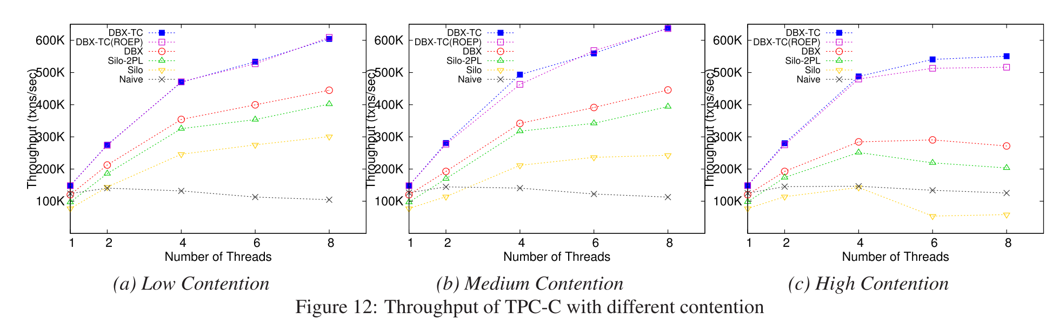
Performance and Scalability
DBX-TC 604,220 txns/sec, 5.77 times compared to naïve usage
Abort rate: DBX: 64%,DBX-TC: 38%
102% speedup compared to DBX

Slide 26
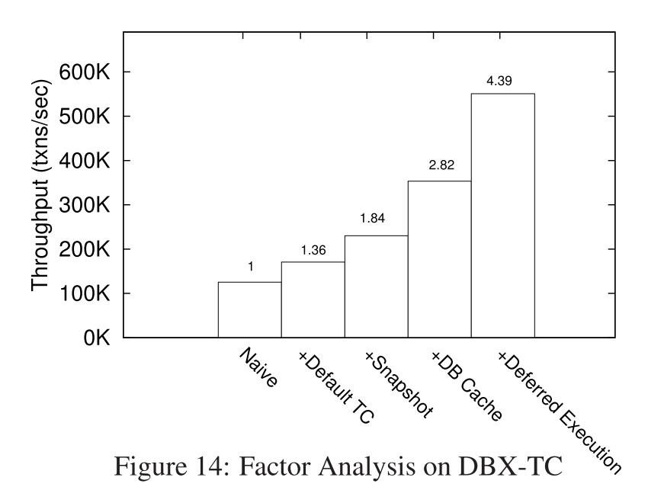
Factor Analysis on Optimizations
x1.56
x1.53
x1.35
x1.36

Slide 27
Recap
Naïve usage of RTM bring high abort rate
Reduce abort rate
Reduce working set size
Graph chopping
Database cache
Reduce transaction conflict rate
Deffered Execution
Read-only Snapshot

Slide 28

Q&A

